Slide 1

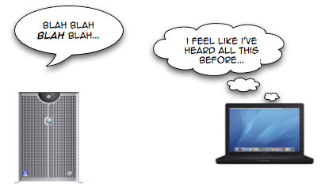


ASP.NET Caching Data
ASP.NET MVC
Telerik Software Academy
http://academy.telerik.com

Slide 2


Table of Contents
Why do we need caching?
ASP.NET Output Caching
OutputCache page directive
Cache profiles
Post-cache substitution
Page fragment caching
Data caching
Cache dependencies

Slide 3
Benefits and Costs of Caching
Benefits of Caching
Performance
Speed – Reduced response time
Efficiency – Reduced infrastructure usage
CPU time, database utilization, network bandwidth
Reduce DB round trips
Costs of Caching
Staleness (out-of-date)
Need to check and refresh data

Slide 4
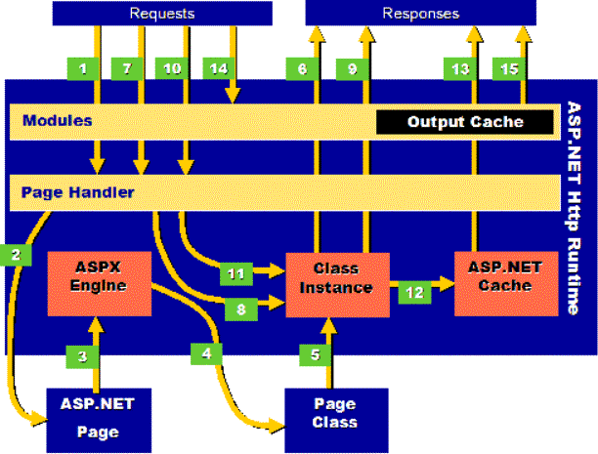
ASP.NET Output Caching

Slide 5
ASP.NET Output Caching
For relatively static pages, rendered content can be cached
OutputCache page directive in ASP.NET
OutputCache action filter in ASP.NET MVC and ASP.NET Web API
<%@ OutputCache Duration="10" VaryByParam="none" %>
[OutputCache(Duration=10)]
public ActionResult MyAction() { ... }

Slide 6
OutputCache Attributes
Name | Values | Description
Duration | number | Time, in seconds, that the page or user control is cached
Location | 'Any' 'Client' 'Downstream' 'Server' 'None' | Controls the header and meta tags sent to clients indicating where this page can be cached. 'Any' means that the page can be cached on the browser client, a downstream server, or the server. 'Client' means that the page will be cached on the client browser only. 'Downstream' means that the page will be cached on a downstream server and the client. 'Server' means that the page will be cached on the server only. 'None' disables output caching for this page.
VaryByCustom | 'Browser' custom string | Either vary the output cache by browser name and version, or by a custom string, which must be handled in an overridden version of GetVaryByCustomString().
VaryByHeader | '*' header names | A semi-colon separated list of strings representing headers submitted by a client.
VaryByParam | 'none' '*' param name | A semi-colon separated list of strings representing query string values in a GET request, or variables in a POST request.

Slide 7
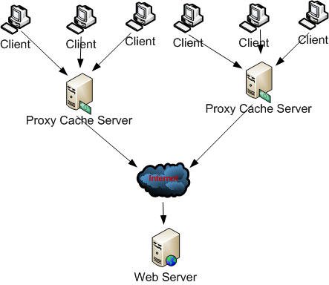
Output caching location
3 types of caching with the 'location' attribute:
server – pages are cached in the worker process
client – pages are cached in client browsers that support it
proxy – pages are potentially cached by downstream proxies
Value | Cache-Control header | Expires header? | Cached on server?
'Any' | public | Yes | Yes
'Client' | private | Yes | No
'Downstream' | public | Yes | No
'Server' | no-cache | No | Yes
'None' | no-cache | No | No

Slide 8
Caching multiple versions of a page
VaryByParam='none' means a unique instance of a page is cached per verb
One for GET, one for POST
If your page changes rendering based on query string or post body, you can use VaryByParam to cache additional versions
"*" means cache a unique page for each different post body and/or query string (beware)
"varname" means cache a unique page for different values of this variable (semi-colon delimited list for multiple variables)

Slide 9
VaryByParam values
A semi-colon separated list of strings representing query string values in a GET request, or variables in a POST request.
Value | Description
'none' | One version of page cached per request type (GET, POST, HEAD)
'*' | N versions of page cached based on query string and/or POST body variables
'v1' | N versions of page cached based on value of v1 variable in query string or POST body
'v1;v2' | N versions of page cached based on value of v1 and v2 variables in query string or POST body

Slide 10
VaryByHeader & VaryByCustom
Other options for creating additional cached pages
VaryByHeader – any HTTP header
VaryByCustom – specify 'Browser' for unique cache entry for each browser type
VaryByCustom with GetVaryByCustomString method in HttpApplication derivative
Return your own string indicating whether it's a separate cache entry or not

Slide 11

OutputCache Demo

Slide 12
Cache Profiles
Cache profiles
Stored in web.config file
No need to recompile
<system.web>
<caching>
<outputCacheSettings>
<outputCacheProfiles>
<add name="ShortLived" duration="10"
varyByParam="none" location="Server" />
<add name="LongLived" duration="3600"
varyByParam="none" location="Server" />
</outputCacheProfiles>
<!-- ... -->
</outputCacheSettings>
</caching>
</system.web>

Slide 13

Cache Profiles Demo

Slide 14
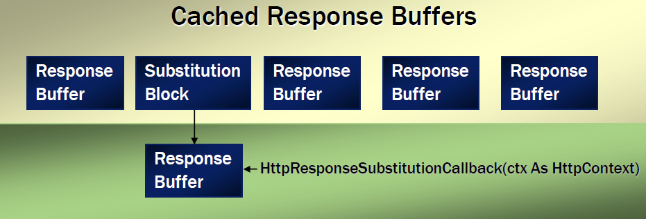
Post-Cache Substitution
Output cache an entire page except some part
This "some part" must consist of a simple string
Use Response.WriteSubstitution with callback
Or use <asp:Substitution /> control with associated callback method
Not supported in ASP.NET MVC

Slide 15
Post-Cache Substitution (2)
Can elect to output cache an entire page except for specifically generated dynamic elements
<%@ Page Language="c#" Debug="true" %>
<%@ OutputCache Duration="60" VaryByParam="none" %>
<script runat="server">
protected static string GetCurrentTime(HttpContext ctx) {
return DateTime.Now.ToString();
}
</script>
<html>
<body>
<form runat='server'>
<%= DateTime.Now %><br />
<% Response.WriteSubstitution(GetCurrentTime); %>
</form>
</body>
</html>

Slide 16
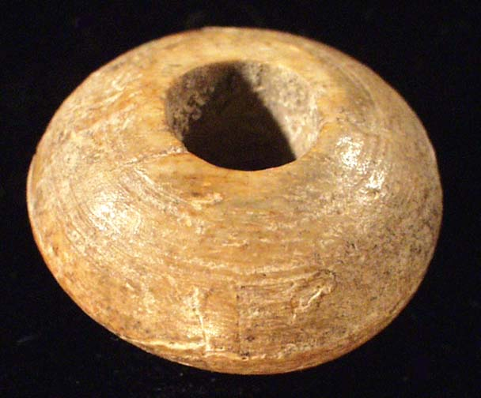
Post-Cache Substitution Demo

Slide 17
Page Fragment Caching
For portions of a page to remain static
Menus, navigation bars, footers, headers, etc.
Cache only some part of the page
WebForms: To cache a page fragment, encapsulate in .ascx (user control) and mark with OutputCache directive
Shared property indicates whether one instance is cached to share across pages
VaryByControl indicates a control value influences unique cache entries

Slide 18
Page Fragment Caching MVC
MVC: To cache a page fragment
1. Encapsulate in child action with [OutputCache] and return partial view:
2. Call the child action from the view
[OutputCache(Duration = 10, VaryByParam = "none")]
[ChildActionOnly]
public ActionResult ChildAction()
{
return this.PartialView();
}
@Html.Action("ChildAction")

Slide 19

Page Fragment Caching Demo

Slide 20
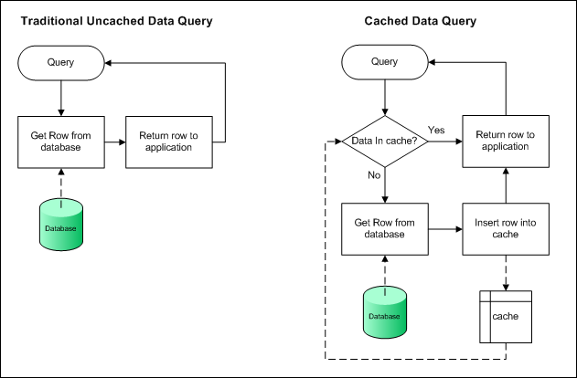
Data Caching

Slide 21
Data Caching
Internally, OutputCaching is built using a sophisticated data cache
Available to you directly through Page.Cache for your own caching needs
this.Cache in ASP.NET WebForms
this.HttpContext.Cache in ASP.NET MVC
if (this.Cache["time"] == null)
{
this.Cache["time"] = DateTime.Now;
}
this.currentTimeSpan.InnerText =
((DateTime)this.Cache["time"]).ToString();

Slide 22
Cache Entry Attributes
When adding cache entries, several attributes can be specified
Each insertion creates a new CacheEntry
Property | Type | Description
Key | string | Unique key used to identify this entry in the cache
Dependency | CacheDependency | A dependency this cache entry has -either on a file, a directory, or another cache entry -which when changed, should cause this entry to be flushed
Expires | DateTime | A fixed date and time after which this cache entry should be flushed
SlidingExpiration | TimeSpan | The time between which the object was last accessed and when the object should be flushed from the cache
Priority | CacheItemPriority | How important this item is to keep in the cache compared to other cache entries (used when deciding how to remove cache objects during scavenging)
OnRemoveCallback | CacheItemRemoved (Callback) | A delegate which can be registered with a cache entry for invocation upon removal

Slide 23
Setting Cache Entry Params
Example of setting cache entry parameters
if (this.Cache["time"] == null)
{
// this.Cache["time"] = DateTime.Now;
Cache.Insert(
"time", // key
DateTime.Now, // value
null, // dependencies
DateTime.Now.AddSeconds(10), // absolute exp.
TimeSpan.Zero, // sliding exp.
CacheItemPriority.Default, // priority
null); // callback delegate
}
this.currentTimeSpan.InnerText =
((DateTime)this.Cache["time"]).ToString();

Slide 24

Removing from the Cache
Objects can be explicitly taken out of the cache
Explicitly by calling Remove
Cache can remove item implicitly for a variety of reasons (Data expiration, Memory consumption)
Low priority cache data will be removed first
Can register for removal notification, including reason

Slide 25

Data Caching Demo

Slide 26
Cache Dependencies
Cache dependencies can ensure that data is not stale
Cache entry can be flushed when:
A file changes
A directory changes
Another cache entry is removed
Something in the database changes
SQL Cache Dependencies

Slide 27

Cache Dependencies Demo

Slide 28
ASP.NET Caching Data
http://academy.telerik.com

Slide 29
Homework
Create new project from the default ASP.NET Web Forms application template and:
Make About.aspx page cacheable for 1 hour
Create cacheable user control
* Add a new web forms page that shows the list of all files in a given directory and caches them till the directory changes
* Learn more about caching by reading about
Data source caching
SQL cache dependencies
http://www.codeproject.com/Articles/29899/Exploring-Caching-in-ASP-NET

Slide 30




Free Trainings @ Telerik Academy
C# Programming @ Telerik Academy
csharpfundamentals.telerik.com
Telerik Software Academy
academy.telerik.com
Telerik Academy @ Facebook
facebook.com/TelerikAcademy
Telerik Software Academy Forums
forums.academy.telerik.com

